Slide 1


TAXI FARE ANALYSIS
Shaiwal Sachdev
Mentor: Sankarshan Mridha

Slide 2


Problem Definition
Aim is to compare and analyze fare data of large number of trips for Taxi Companies mainly New York Yellow Cabs and Uber.
We will also try to predict the value of surcharge at a given location and time.
The analysis is focused on New York region only.

Slide 3
Dataset
For this work we used two datasets. NYC Yellow taxi data and Uber Data.
NYC Dataset
Uber Dataset
  We selected popular origin, destination (OD) pairs from the NYC dataset for different hour bucket and get fare data from Uber API.
  For comparison, we focused on four different one hour time buckets,
  6 [5:30am-6:30am], 10 [9:30am-10:30am], 16 [3:30pm-4:30pm], 20 [7:30pm-8:30pm] and collected uber data for 425308 OD pairs.
Pickup (Lat,Lon) | Dropoff (Lat,Lon) | Distance (miles) | Duration (seconds) | Total Fare (USD) | Time stamp
Min Fare (USD) | Low-High Estimated Fare (USD) | Distance (miles) | Duration (seconds) | Surcharge Multiplier

Slide 4
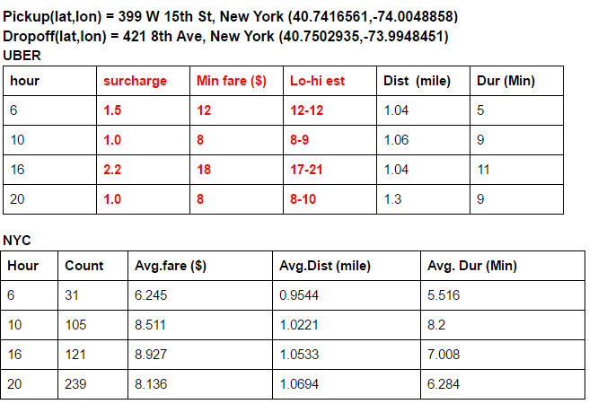
Analyze Data

Slide 5
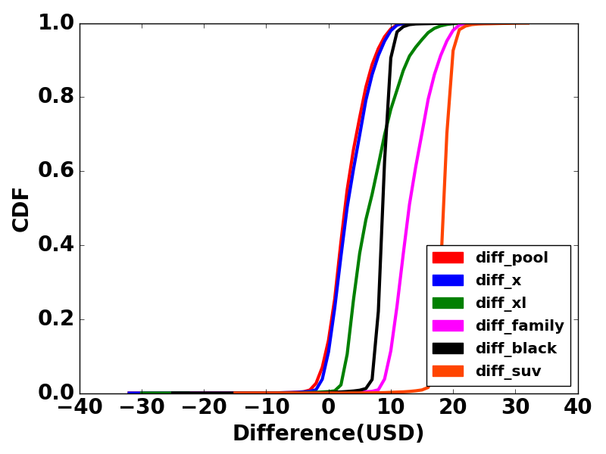
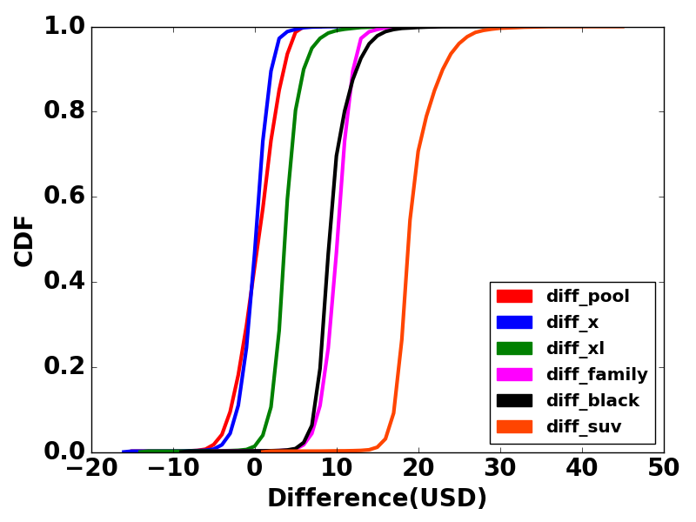
Fare Comparison(Cumulative Distribution Function)
HOUR 6
Cheapest UberX is costlier than NYC
HOUR 10
Uber costs almost equal to NYC cabs

Slide 6
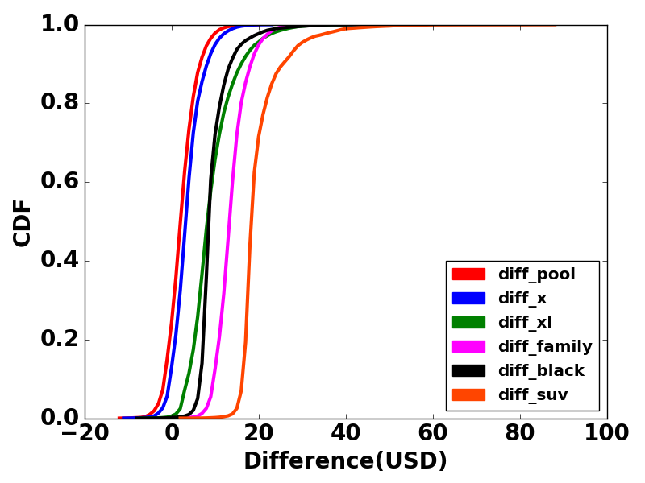
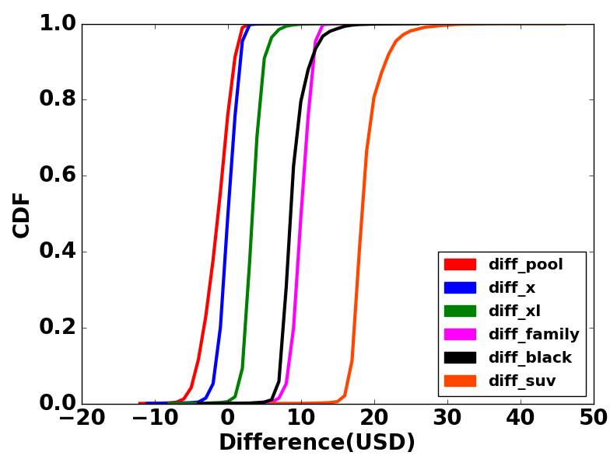
HOUR 16
Cheapest UberX is costlier than NYC
Uber is costly during early morning and in the evening time when the demand-supply ratio is > 1
HOUR 20
Uber costs almost equal to NYC cabs

Slide 7
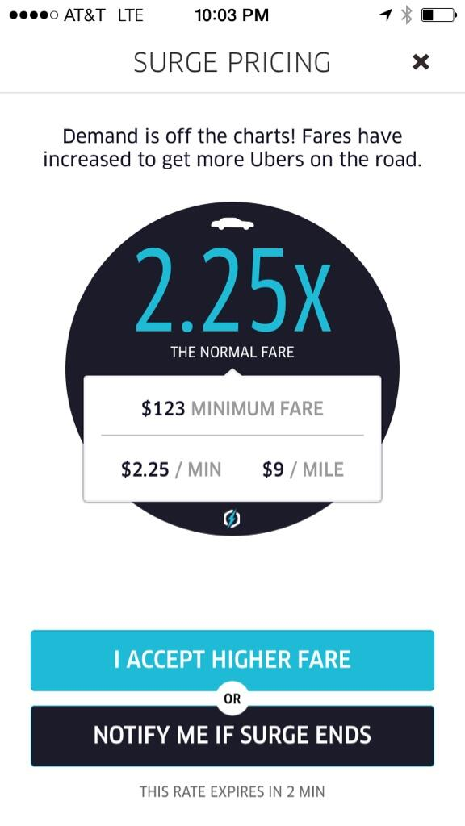
Surcharge Estimator
  After doing the analysis ,we found out that uber earns most of the its money by its dynamically changing Surcharge values.
  Surcharge Multiplier =
  (Demand By Customers)/(Supply of Drivers).
  Can we make a model that will predict the surcharge value giving the following inputs
    1. pickup location
    2. dropoff location
    3. Hour
    4. cab service

Slide 8
Generating Data
Assuming uniform supply of drivers. We consider, according to Anastasios et al [1], that surcharge only depends on the Popularity of the pickup location.
Fields:
  Latitude of pickup location
  Longitude of pickup location
  Popularity (Number of trips originated from Pickup locations irrespective of dropoff)
  Average Surcharge of all the trips originated at that Pickup location.
1. Mining open datasets for transparency in taxi transport in metropolitan environments Anastasios Noulas1,3*, Vsevolod Salnikov2, Renaud Lambiotte2 and Cecilia Mascolo1, EPJ Data Science 2015

Slide 9
Proposed Model

Slide 11
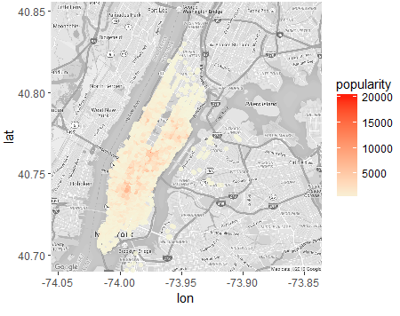
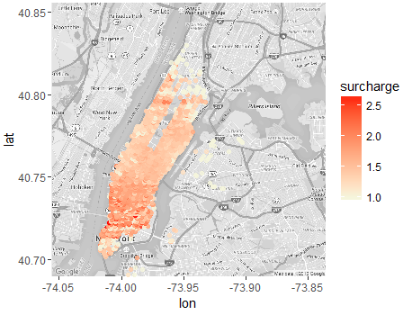
Heatmap (Hour 16)
Original Popularity from NYC data
Original Surcharge from Uber

Slide 12
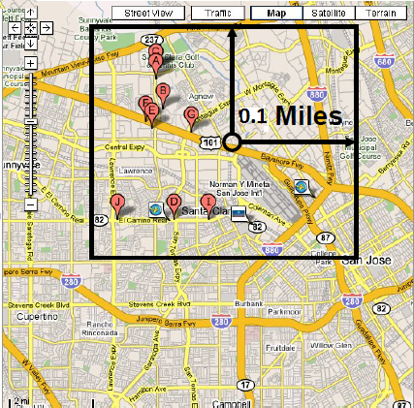


Popularity Estimator
The demand (popularity) at a test location depends on the popularity of neighbour.
Start with a distance of 0.1 mile and go on searching upto 1 mile till we find at least one neighbouring location.
We can take the average of demand of all locations within the bounding box. This method did not give us good results.
Even within the bounding box ,the location
nearer should have more effect or more weight.
So we use Inverse Distance Weighting Average(IDW)

Slide 13



Surcharge Estimator
We give popularity as of a location as input and get estimated surcharge as output for a fixed hour.
Locally Weighted Regression(LWR)
Estimated value of surcharge should depend
on local regions more.
Let X0 be the popularity of the new location.
Find the squared difference between X0 and
its neighbors. We will use this distance for the
weight function.
Find diagonal weight matrix.
X is estimated popularity
Y is surcharge

Slide 14
MSE for Surcharge Estimation
Hour | 6 | 10 | 16 | 20
Linear Regression | 0.0287 | 0.0221 | 0.0422 | 0.0239
Decision Tree Regression | 0.02713 | 0.01980 | 0.03089 | 0.0231
KNN Regression (k- nearest neighbor) | 0.02806 | 0.02050 | 0.03680 | 0.02720
Locally Weighted Regression(LWR) | 0.0029 | 0.0031 | 0.00334 | 0.00168
For the above MSE the original range of surcharge values lie from 1 to 2.0

Slide 15
Average Estimated Surcharge vs Real Surcharge
We took a set of 50 random OD pairs from New York City which are not present in the dataset.
For each OD pair we estimated the average surcharge and compared against the Uber surcharge.
The Mean Square Error ranges between 0.01 and 0.20.
Hour | 6 | 10 | 16 | 20
MSE | 0.061 | 0.01 | 0.20 | 0.02
For the above MSE the original range of surcharge values lie from 1 to 3.0

Slide 16
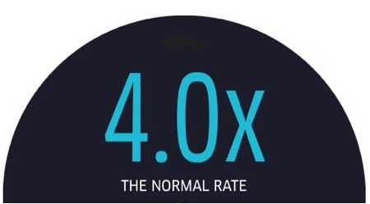

Conclusion
The proposed model estimates the average surcharge at a location with maximum Mean Square Error of 0.003.
This model helps to predict the surcharge of a location using history data. So the user can plan accordingly.
This model also helps to compare the estimated surcharge given by Uber against the estimated surcharge of the location using history data.
Next Hour

Slide 17


